Slide 1


Countering SQL Injection Attacks
in
Web Application
Ritika Ahuja (07113103109)
Hitesh Kumar (07213103109)
Sushant Gandhi (07713103109)

Slide 2
Aim of the Project
Analyzing the vulnerability of Web Applications to SQL Injection Attacks (SQLIAs)
Propose a system for detection of SQLIAs
Provide minimum overhead for developers and admins to implement the technique
Improve on limitations of current stastical models

Slide 3
What is SQL Injection?
Structured Query Language ('SQL') is a textual language used to interact with relational databases
SQL Injection occurs when an attacker is able to insert a series of SQL statements into a 'query' by manipulating data input into an application
SQL injection attacks (SQLIAs) are one of the major security threats for Web applications
Successful SQLIAs can give attackers access to and even control of the databases that underly

Slide 4
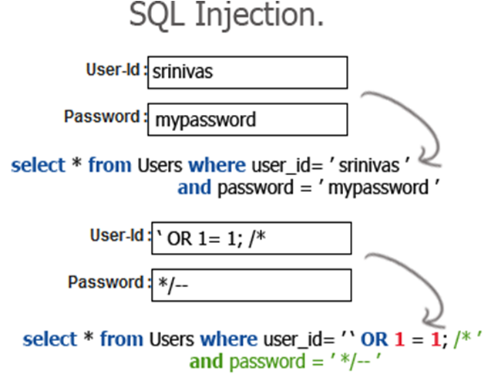
Example of SQL Injection Attack

Slide 5
SQLIA Types
Tautologies
Inject code in one or more conditional statements so that they always evaluate to true
SELECT accounts
FROM users
WHERE login = ‘’ or 1=1 --’ AND pass = ‘’
AND pin =

Slide 6
Illegal/Logically Incorrect Queries
Inject statements that cause a syntax, type conversion, or logical error into the database
SELECT accounts
FROM users
WHERE login = ‘’ AND pass = ‘’
AND pin = convert(int, (select name
from sysobjects where xtype = ‘u’))

Slide 7
Union Query
Inject a statement of the form:
UNION SELECT <rest of injected query>
SELECT accounts FROM users WHERE login = ‘’ UNION
SELECT cardNo from CreditCards where
acctNo = 10032 --‘ AND pass = ‘’ AND pin =

Slide 8
Traditional Approach
Dynamic analysis or tainting is ability to monitor code as it executes
It is marking and tracking data through the program at run time
It is further divided into
Positive Tainting
Negative Tainting

Slide 9
Proposed Approach
Our approach against SQLIAs is based on
Positive Tainting
Character Level Tainting
Syntax Aware Evaluation

Slide 10
Positive Tainting
Positive tainting is preferred over negative tainting
As it works on subset of trusted data rather than untrusted data
With positive tainting, incompleteness may lead to false positives, but never results in an SQLIA escaping detection
While in Negative tainting any incomplete query may pass as complete query

Slide 11
Implementing Positive Tainting
Algorithm :
When the input String contains ASCII value 27 to 122 i.e. it contains upper, lower character and some symbol then read contains of foo.txt (foo.txt includes the marked data) .it is nothing but tracking and marking of data.
Then split the string and check account no. and password and tell the administrator SQL injection found or not.

Slide 12
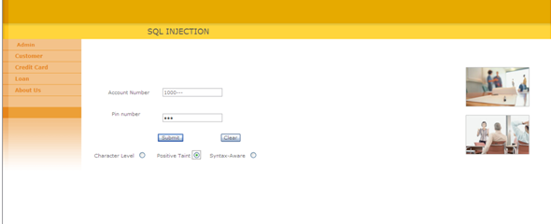
Output: If inserted Query is correct then query processes and give user access to database else deny access and display injection type.

Slide 13
Character level Tainting
Algorithm :
Input string.
Check in String presence of symbol ‘-‘ if this found check next symbol is’-‘ if this found then give injection type and exit.
check string presence of 'O' or 'o' if found check if next character is ‘r’ or’R’. if found then tell injection type and exit.
Check in String prensence of ’;’ if found then give failure result and injection type and exit.

Slide 14
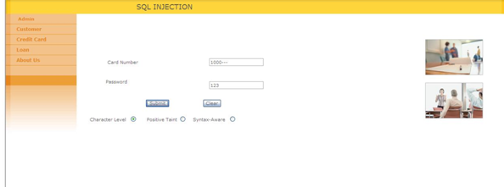
Output: If inserted Query is correct then query processes and gives user access to database else deny access and display injection type.

Slide 15
Syntax Aware Evaluation
Algorithm :
Input string and set syntax.
If inserted query is equal to database Query then split the query into substring and check the syntax and then display final query .

Slide 16
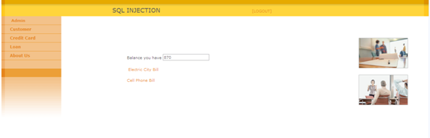
Output: After checking the syntax of the query then insert all the details in the database.

Slide 17
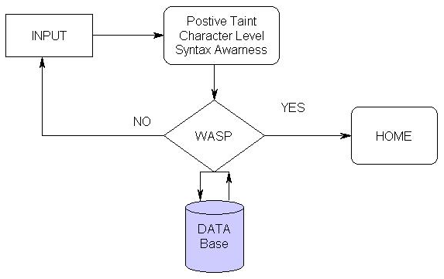
System Design

Slide 18
Admin Module

Slide 19
Customer Module

Slide 20
Credit Card Module

Slide 21
Advantages
Our approach is highly automated & in most cases require minimal or no developer intervention.
It does not require additional infrastructure and can be automatically deployed.
We use Positive tainting which leads to increased automation.
Our approach is the use of flexible syntax aware evaluation.

Slide 22
Disadvantages
We need to reconfigure project as per client request.
Subset of queries need to be formatted at the time of deployment.

